Slide 1
Digital Portfolio
STUDENT NAME: DINESH J
REGISTER NO: 20324U48007
NMID: 909CC2D55BB8EADBC5F404504FCAB82B
DEPARTMENT: B. Sc. DATA SCIENCE
COLLEGE: DR. M. G. R. CHOCKALINGAM ARTS COLLEGE,ARNI
UNIVERSITY: THIRUVALLUVAR UNIVERSITY

Slide 2
PROJECT TITLE
Digital portfolio website development using html ,css & javascript

Slide 3


AGENDA
Problem Statement
Project Overview
End Users
Tools and Technologies
Portfolio design and Layout
Features and Functionality
Results and Screenshots
Conclusion
Github Link
3/21/2024 Annual Review

Slide 4

PROBLEM STATEMENT
In today’s increasingly digital world, individuals lack a centralized, professional, and easily accessible platform to showcase their skills, accomplishments, and personal brand. Traditional resumes and paper-based portfolios are static, limited in content, and fail to effectively communicate creativity, technical skills, and real-world experience. This creates challenges for students, freelancers, and professionals in standing out to potential employers, clients, or collaborators.
There is a need for a dynamic digital portfolio solution that allows users to present their work, credentials, and personal narrative through a visually appealing, interactive, and customizable online presence. Such a platform should be easy to create, maintain, and share, enabling users to build credibility and enhance visibility in competitive environments.

Slide 5

PROJECT OVERVIEW
A responsive and interactive personal website designed to
Showcase my skills,and learning journey in web development.
To design and develop a fully responsive and interactive digital portfolio website using HTML, CSS, and JavaScript, aimed at showcasing personal skills, projects, achievements, and contact information in a professional and visually appealing format.

Slide 6

WHO ARE THE END USERS?
🧑‍💻 Who Are the End Users of a Digital Portfolio Website?
1. Potential Employers / Recruiters
They use the portfolio to assess your skills, past work, and professionalism.
It helps them quickly evaluate if you’re a good fit for a job role.
2. Clients (for Freelancers or Agencies)
Clients review portfolios to determine if your style, skills, and experience align with their needs before hiring you.
3. Academic Institutions / Admission Committees
Used for applications to design or tech programs, internships, or scholarships.
Helps assess your creative or technical work in one place.
4. Peers & Collaborators
Fellow professionals may visit your portfolio for inspiration or to connect for collaboration or networking.
5. Mentors / Instructors
In educational environments, mentors and teachers use your portfolio to track learning progress and give feedback.
6. General Public / Online Visitors
Anyone interested in your work (e.g., blog readers, fans, or community members) may explore your site to learn more about you.

Slide 7

TOOLS AND TECHNIQUES
👨‍💻 Technologies Used:
HTML5 – Structure and semantic layout.
CSS3 – Styling, layout, and responsiveness.
JavaScript (ES6) – Interactivity, animations, form validation, and dynamic content.
Visual Studio code- The code editors
GitHub- An Version control Platform used to host the project output
Microsoft Edge- Used to showcase the output and to check wheter the output is correct or not.

Slide 8
POTFOLIO DESIGN AND LAYOUT
🧱 1. Layout Structure
Your digital portfolio will typically consist of the following sections:
🔹 Header / Navigation Bar
Logo or name on the left
Menu items (Home, About, Projects, Contact)
Sticky or scroll-activated for easy access
🔹 Hero Section (Landing Area)
Full-width banner with your name, role (e.g., "Frontend Developer"), and a tagline
Call-to-action button (e.g., “View My Work”)
🔹 About Me
Brief personal background
Skills overview (icons or progress bars)
Resume link or download button
🔹 Projects / Portfolio
Grid or card layout
Each project includes:
Title and description
Screenshot or thumbnail
Tools/technologies used
View demo / GitHub link
8

Slide 9
🔹 Contact Section
Simple form (Name, Email, Message)
Social media links (LinkedIn, GitHub, etc.)
🔹 Footer
Contact info or quote
Copyright notice
Quick navigation or icons
🎨 2. Design Principles
Consistency: Use a fixed color palette and font styles throughout.
Whitespace: Give elements room to breathe for readability and aesthetics.
Visual Hierarchy: Make headings, buttons, and key sections stand out.
Responsiveness: Ensure layout adapts for all screen sizes (mobile-first design).
Accessibility: Use good contrast, alt text for images, and keyboard navigation.
🧰 3. Tools for Design
Wireframing: Figma, Adobe XD, or pen & paper
Icons: Font Awesome, Heroicons
Fonts: Google Fonts (e.g., Roboto, Lato, Poppins)
Colors: Coolors or Adobe Color for palette inspiration

Slide 10
FEATURES AND FUNCTIONALITY
🌐 Core Features:
🔹 Responsive Design
Works seamlessly across mobile, tablet, and desktop devices.
Uses CSS media queries and flexible layouts (Flexbox/Grid).
🔹 Interactive Navigation
Fixed or sticky header with smooth scrolling.
Highlight active sections while scrolling (scroll spy).
🔹 Project Showcase
Grid or card layout.
Each project includes:
Title & short description
Tools/technologies used
Live demo & GitHub links
Hover effects or modal previews

Slide 11
RESULTS AND SCREENSHOT
✅ Structure & Pages
Homepage (index.html):
Header Navigation (sticky): Links to:
About
Projects
Contact
Hero Section:
Your Name & Title (e.g., "Web Developer")
Brief tagline or summary
“View My Work” button with smooth scroll
About Section:
A brief introduction about you
Your skills, background, or mission

Slide 12
Projects Section:
Cards for each project
Title
Short description
Link to view the project or GitHub
Contact Section:
Form with:
Name
Email
Message
Button to send message
JavaScript handles submission with an alert message

Slide 13
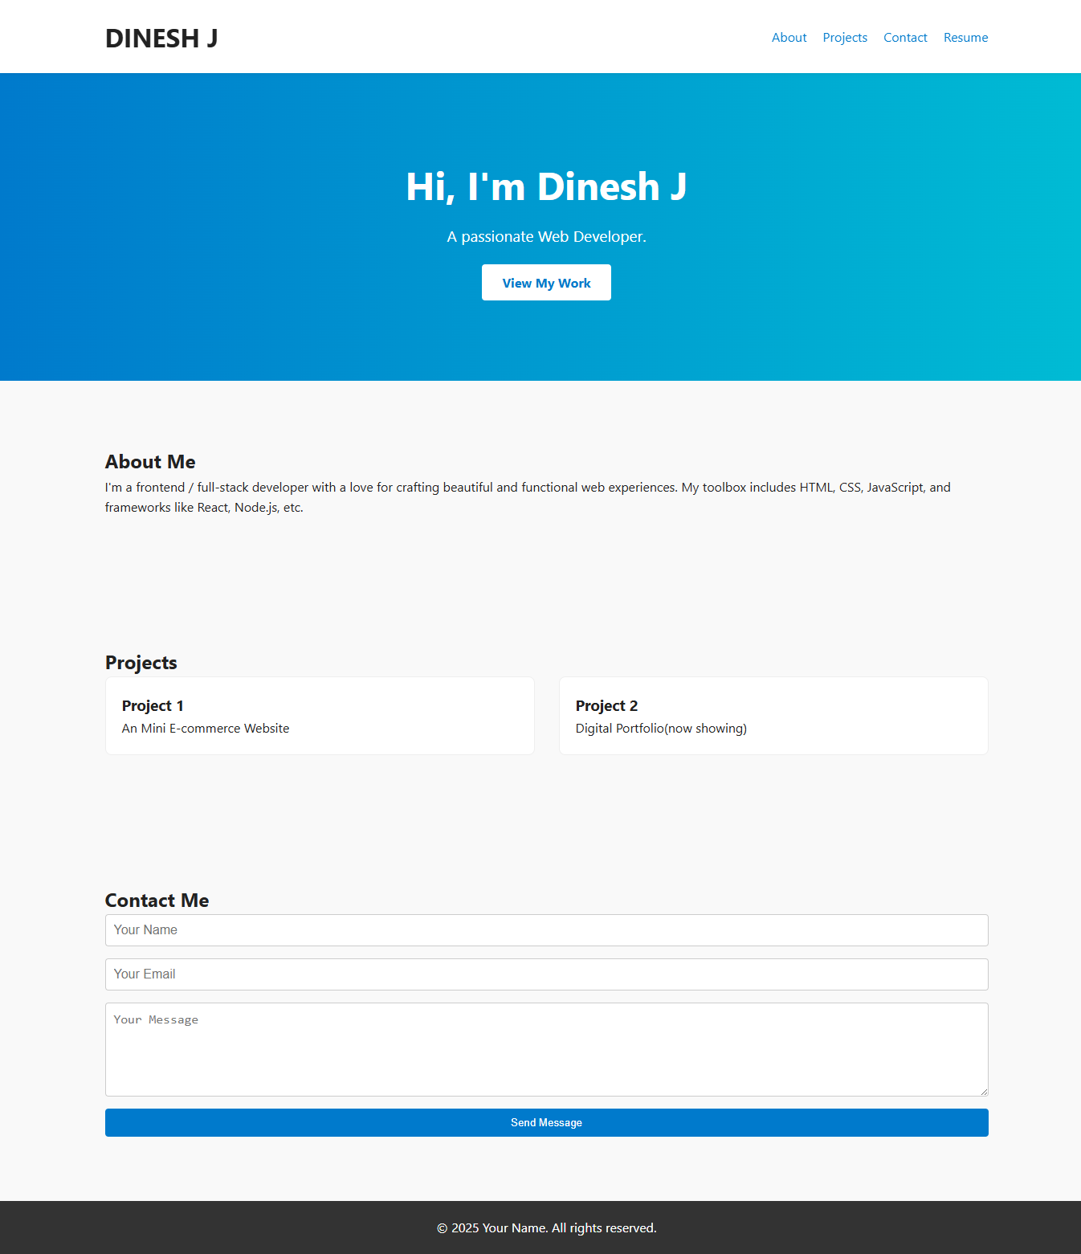

SCREENSHOTS
3/21/2024 Annual Review
13

Slide 14
CONCLUSION
Creating a digital portfolio website is a powerful way to showcase your skills, projects, and professional identity on the web. The portfolio we built using HTML, CSS, and JavaScript provides a strong foundation with:
A clean, responsive design
Clear navigation and structure
Space to highlight your work and accomplishments
An easy way for potential clients or employers to contact you
14

Slide 15
GITHUB LINK
https://github.com/dineshjayakumarr/Digital-Portfolio.git
PROJECT OUTPUT LINK
https://dineshjayakumarr.github.io/Digital-Portfolio/

